Slide 1
SAIL 进展介绍及动态分享
6月13日
PLCT Lab 阎明铸

Slide 2
Outline
Sail model assembly
Sail in riscv-unified-db
Sail lean backend
ACT self-checking mode

Slide 3
1. Sail Model Assembly

Slide 4
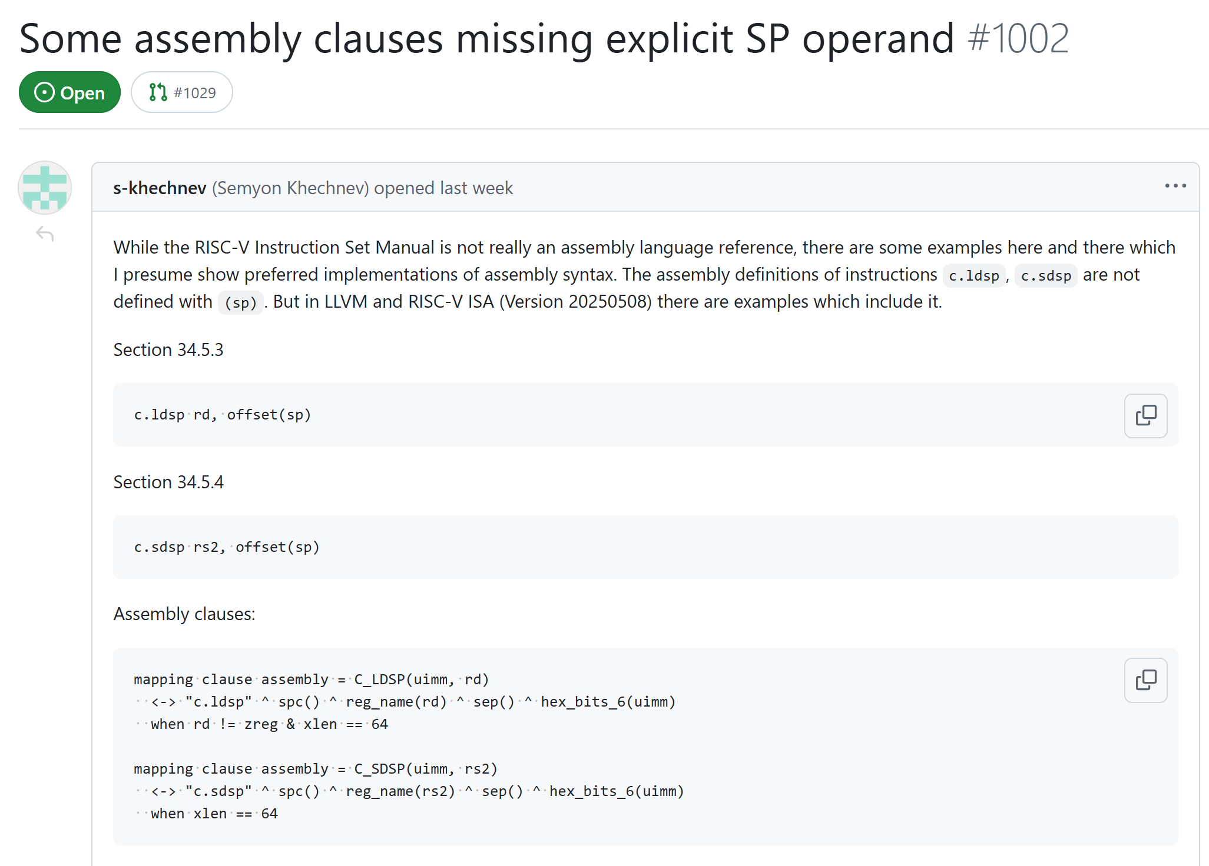
Issue
https://github.com/riscv/sail-riscv/issues/1002

Slide 5
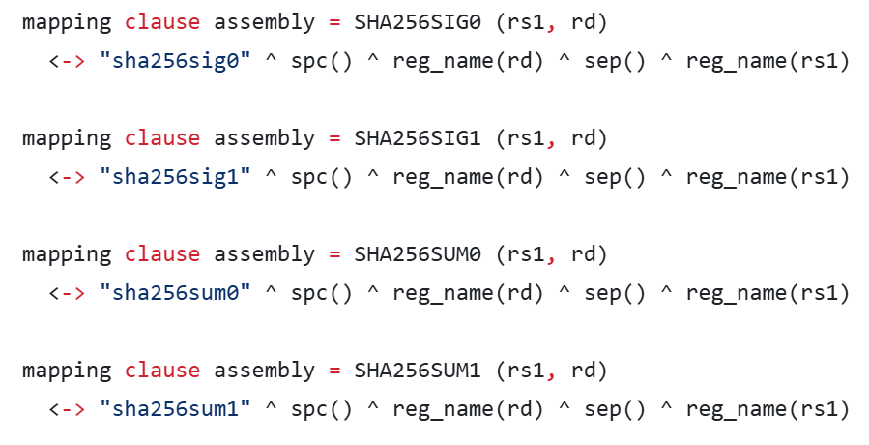
Sail model assembly

Slide 6
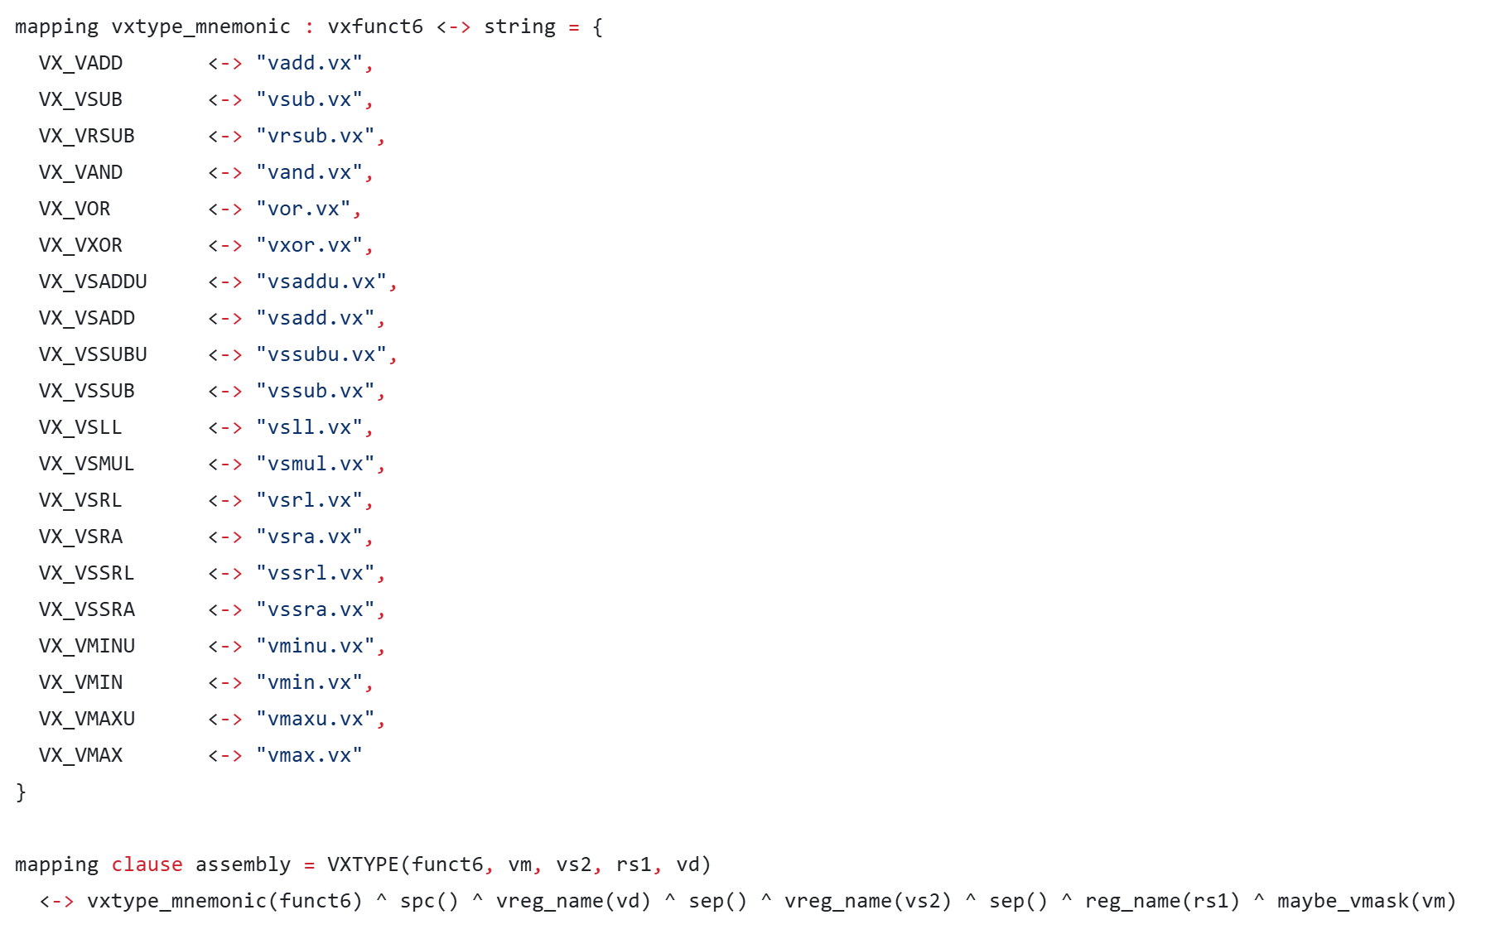
Sail model assembly

Slide 7
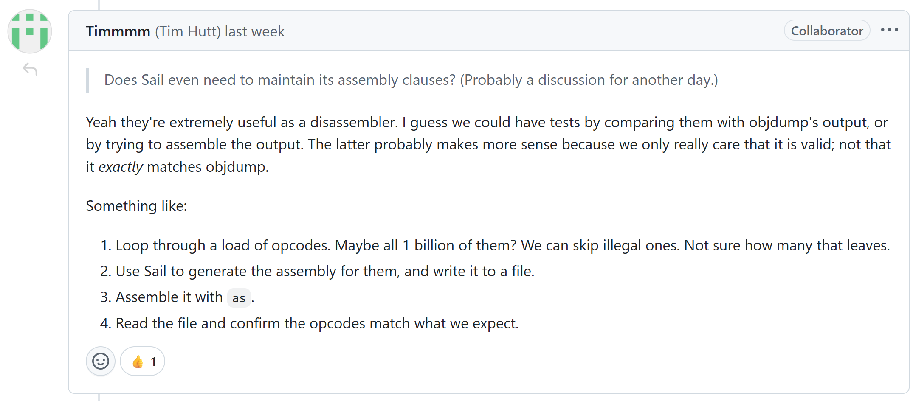
Test plan

Slide 8
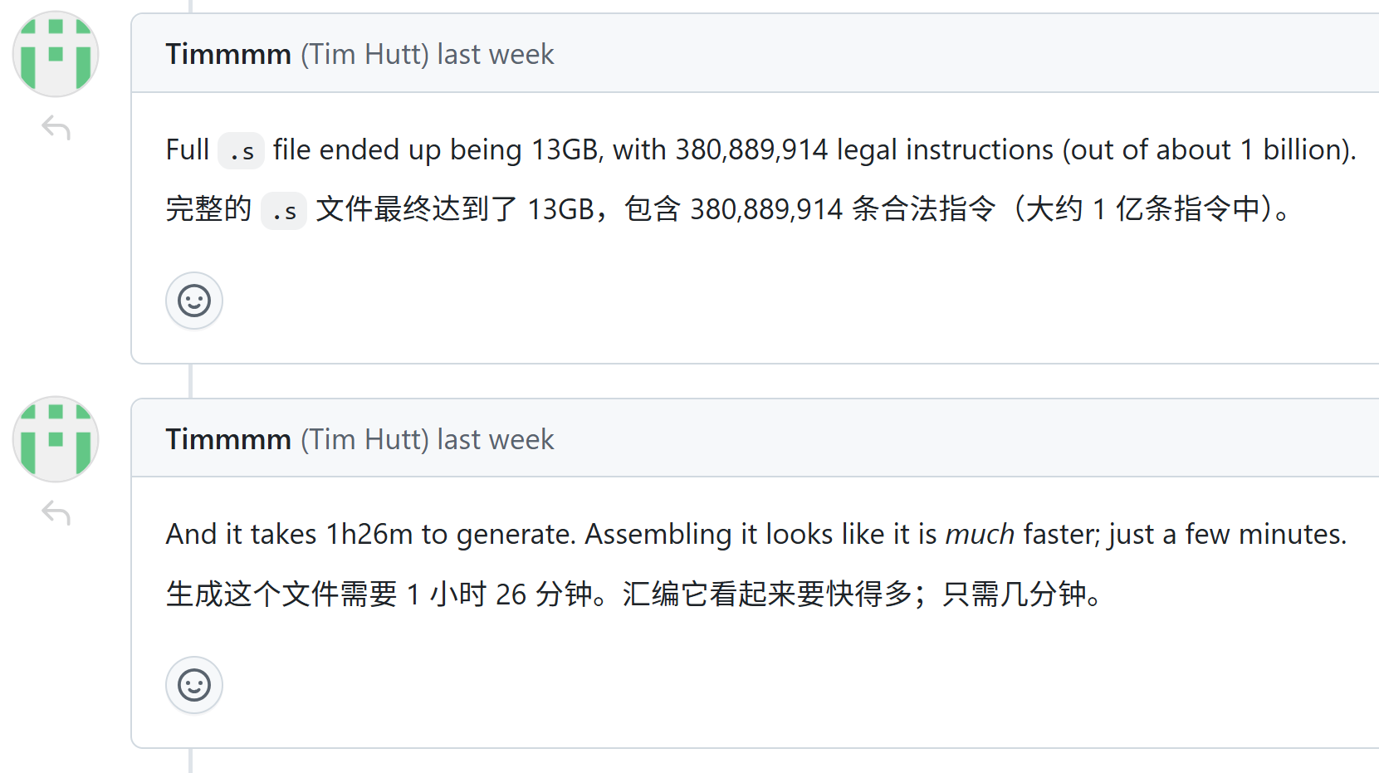
Test profiling

Slide 9
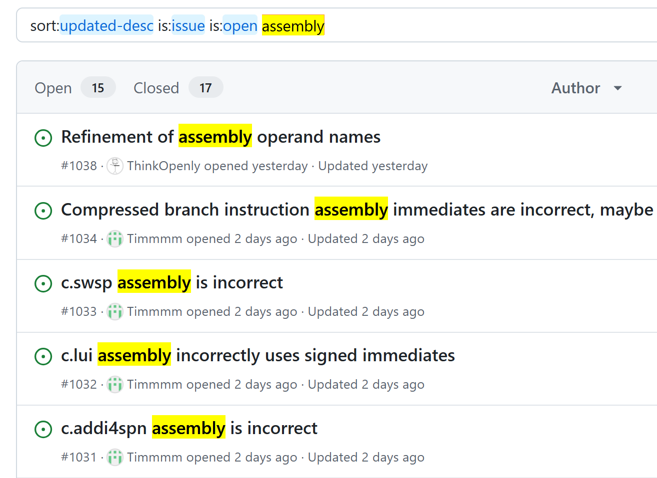
Assembly Issues

Slide 10
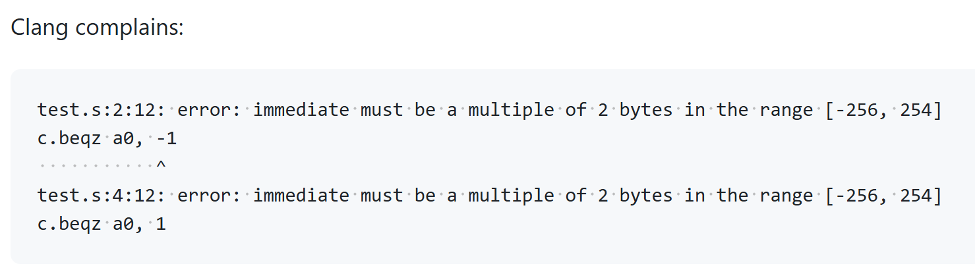
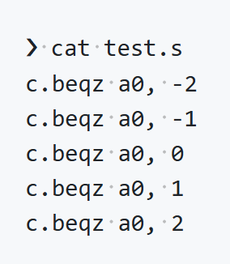
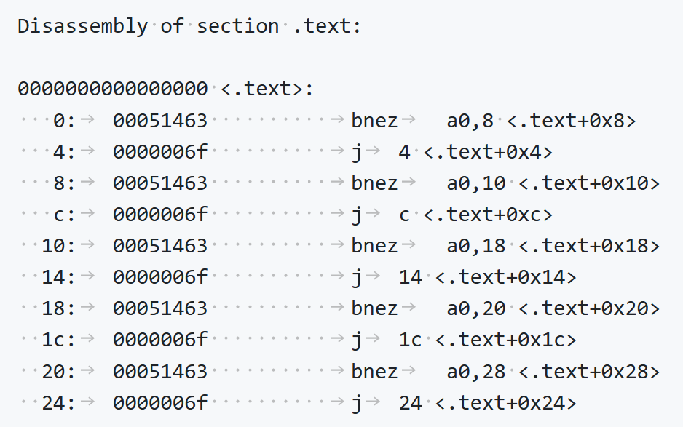
c.beqz assembly

Slide 11
2. Sail in riscv-unified-db

Slide 12

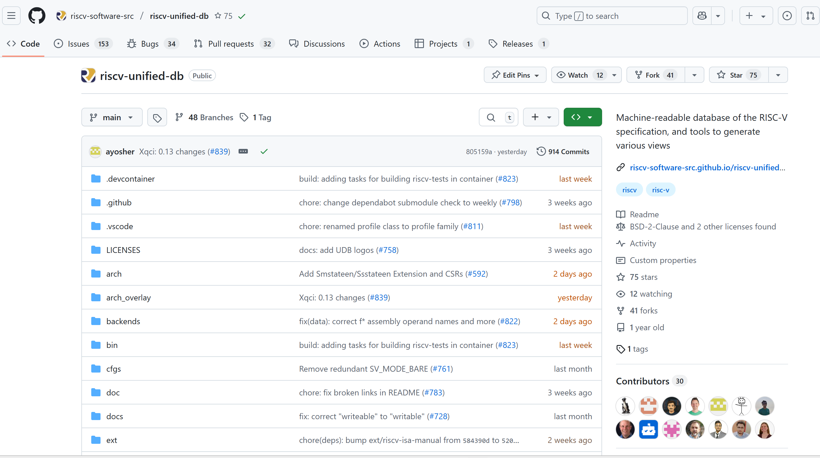
riscv-unified-db
Machine-readable database of the RISC-V specification, and tools to generate various views

Slide 13
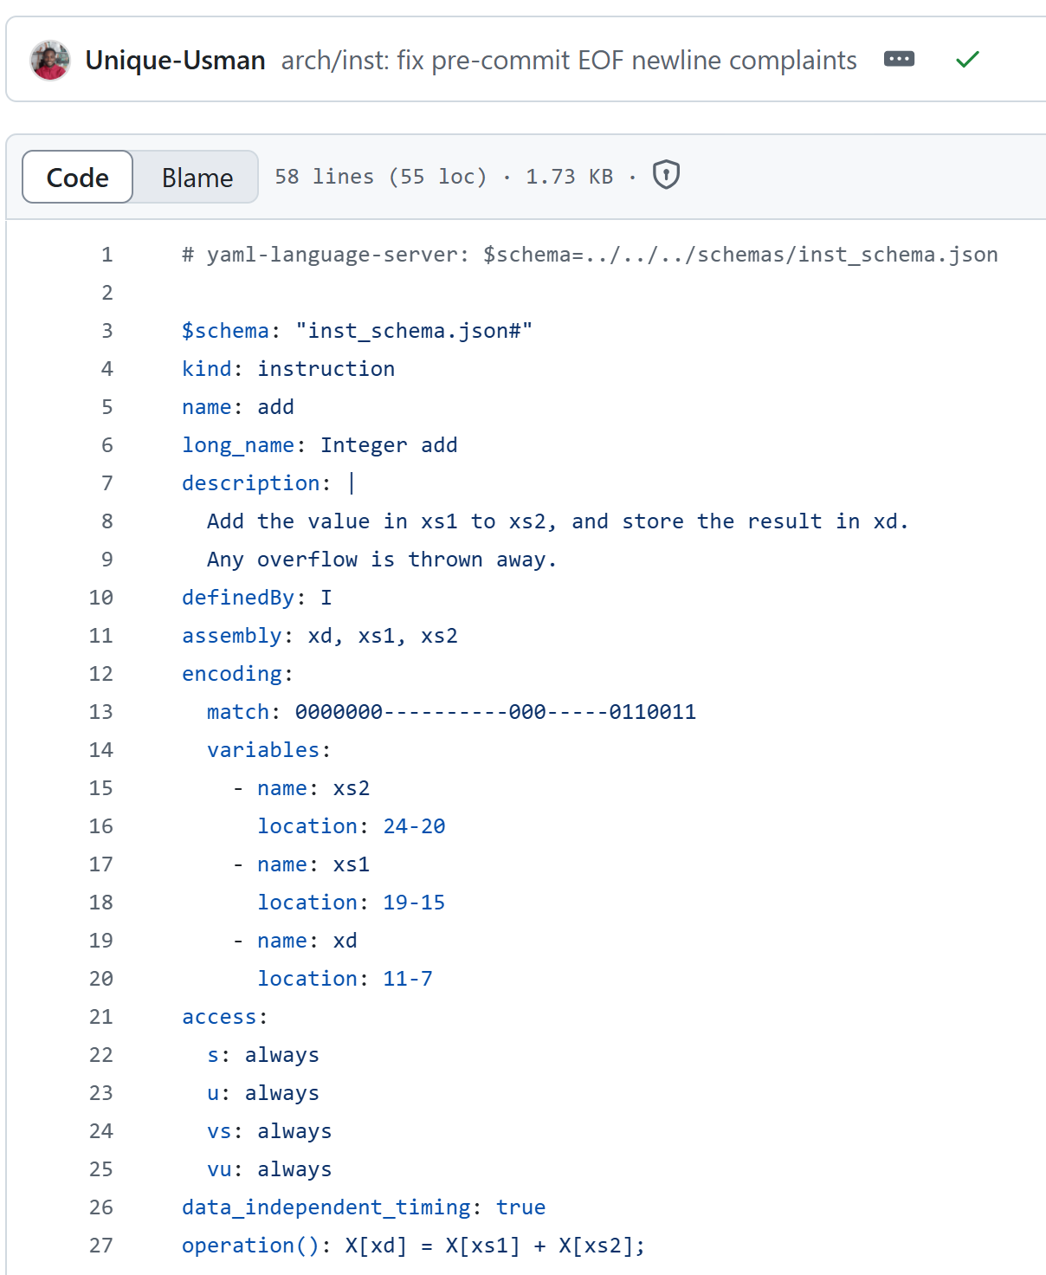
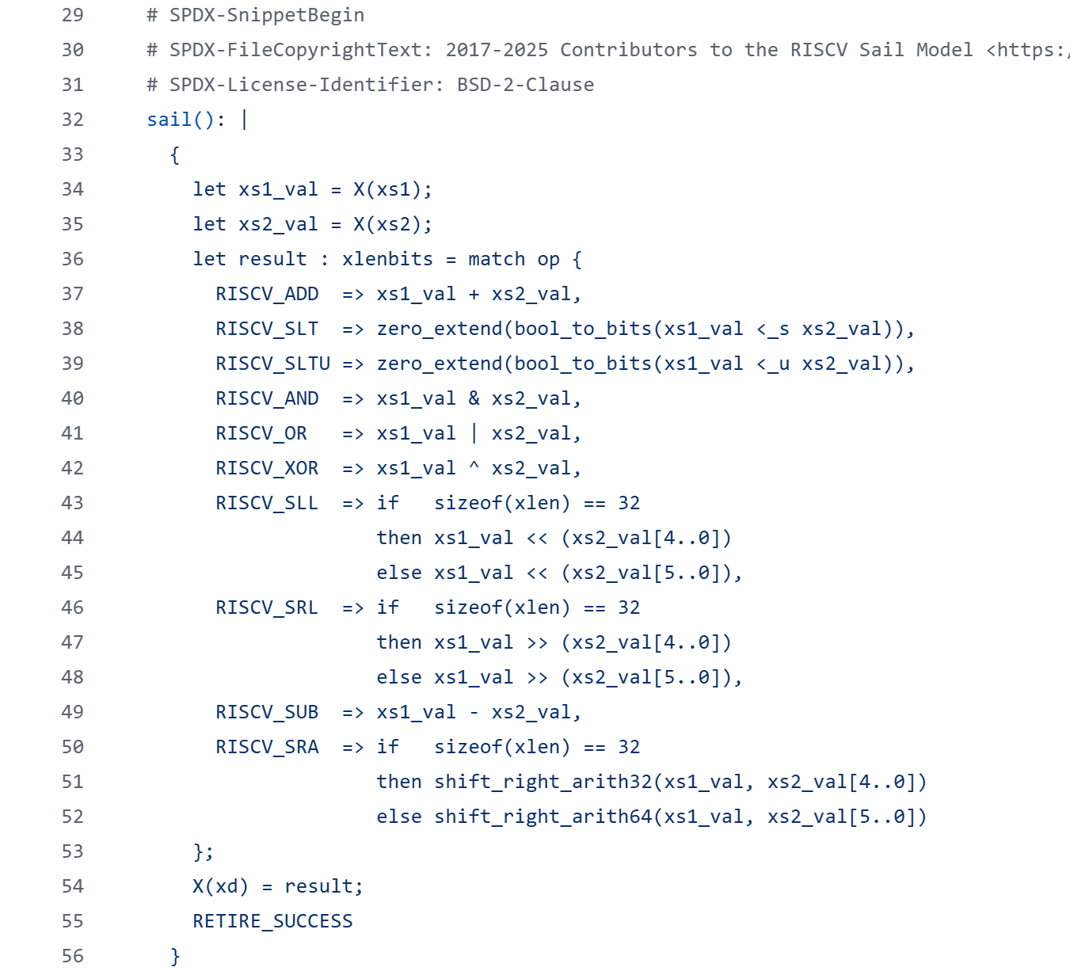
riscv-unified-db

Slide 14
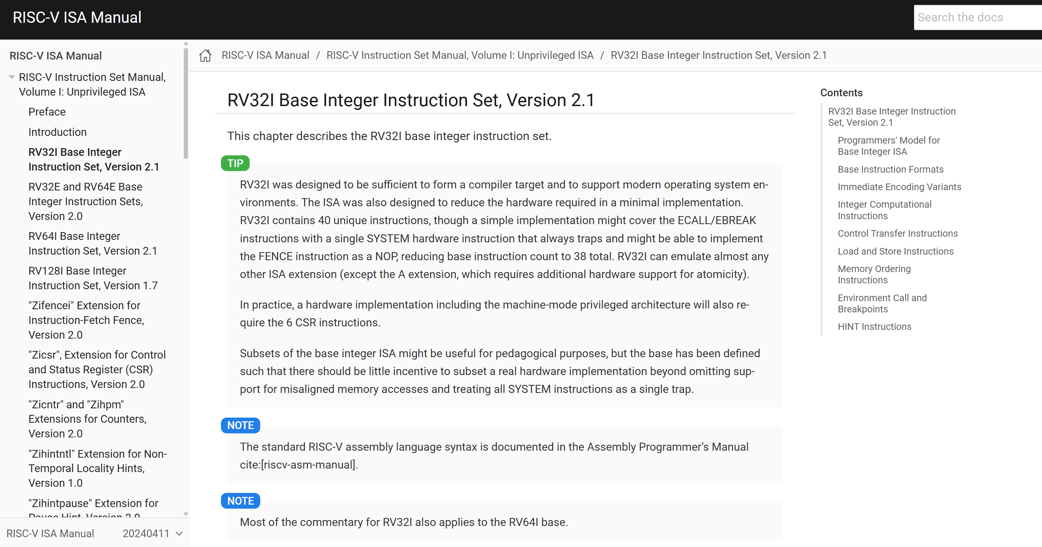
Generated html

Slide 15
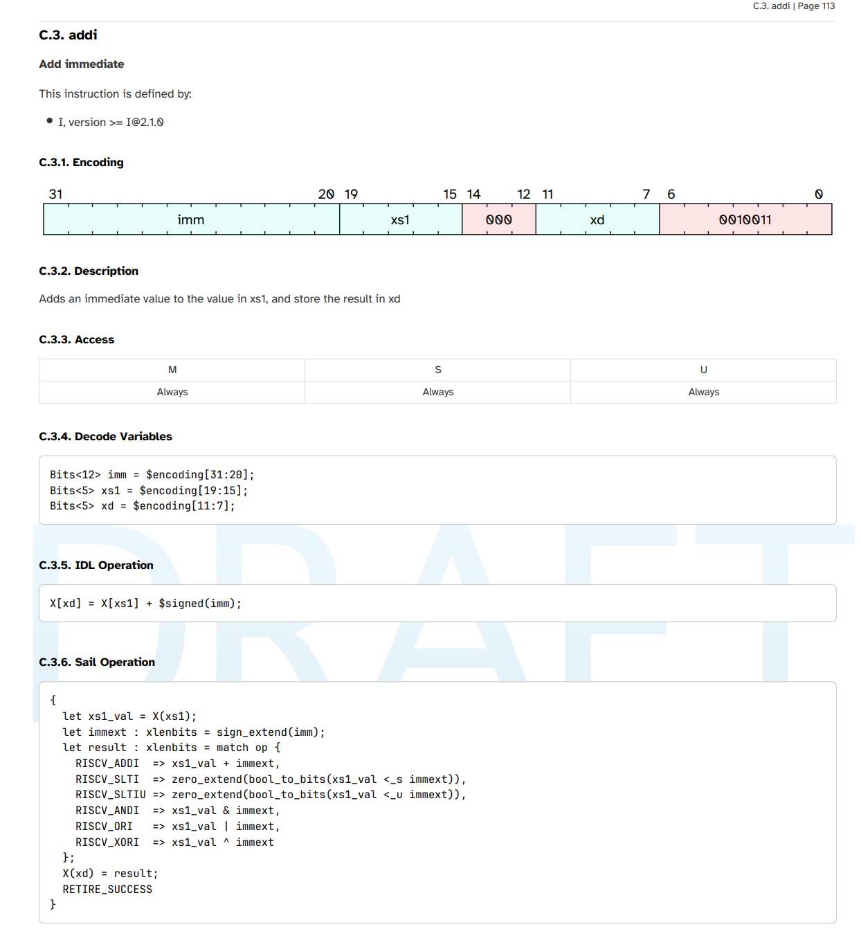
Generated pdf

Slide 16
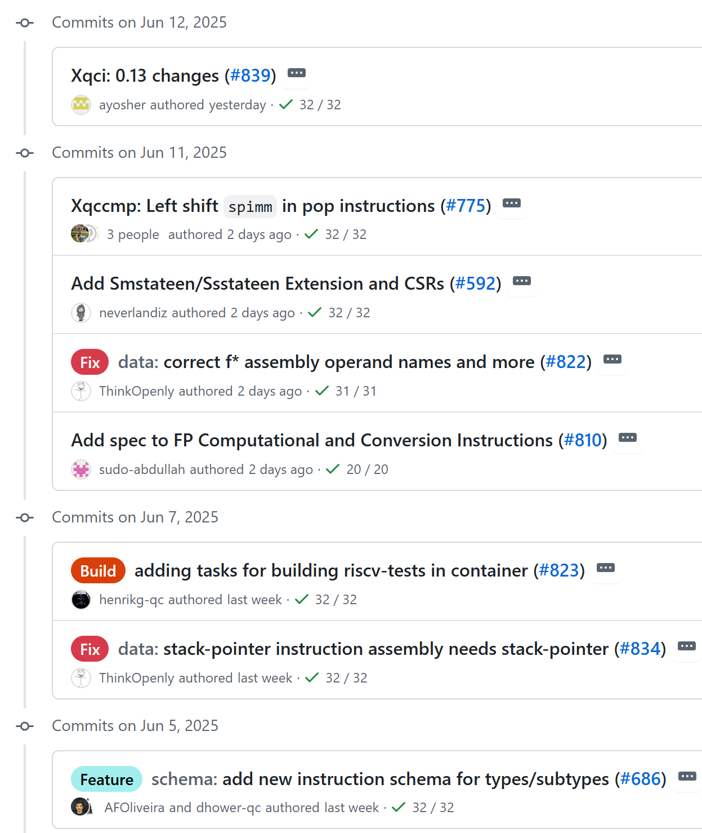
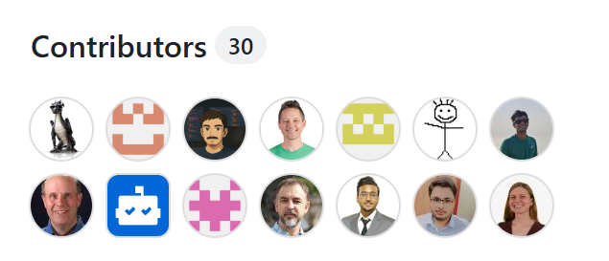
riscv-unified-db

Slide 17
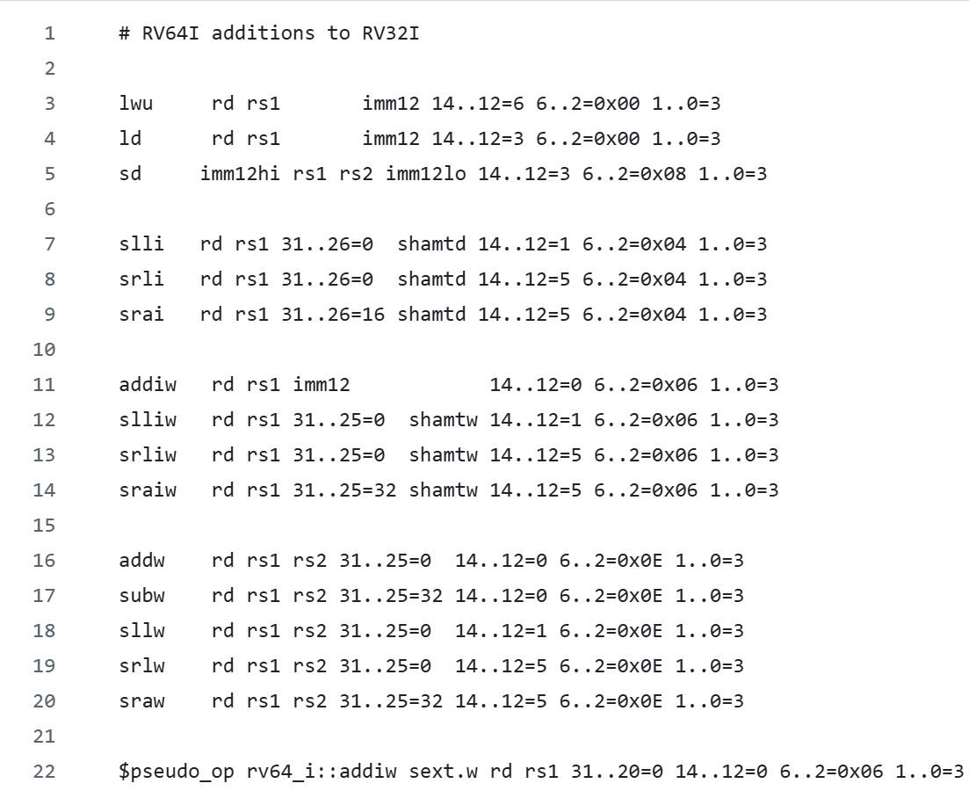
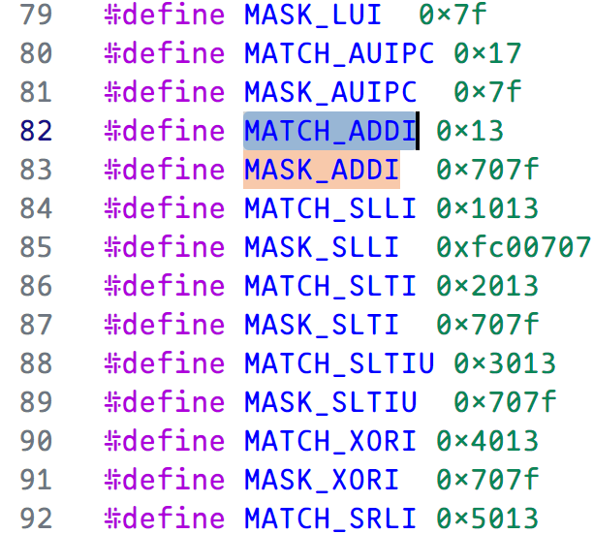
riscv-opcodes
https://github.com/riscv/riscv-opcodes

Slide 18
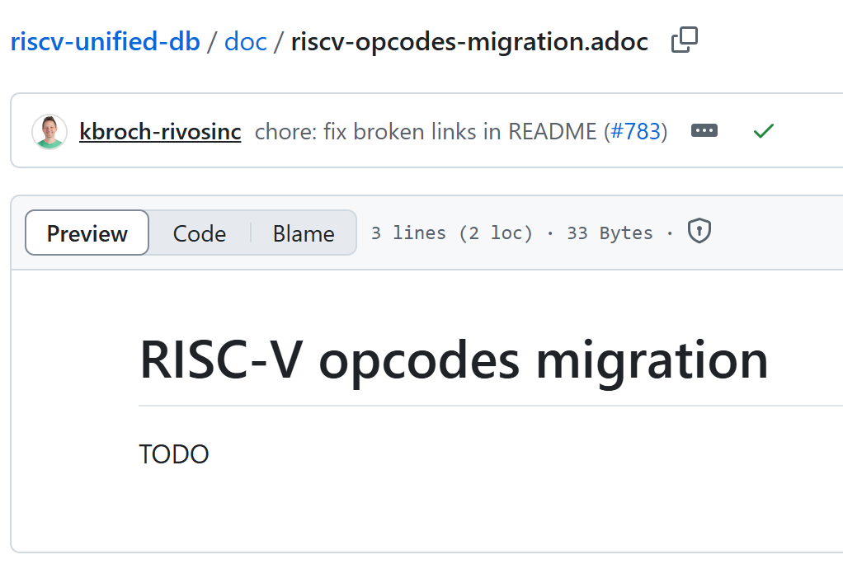
riscv-opcodes

Slide 19
3. sail lean backend

Slide 20

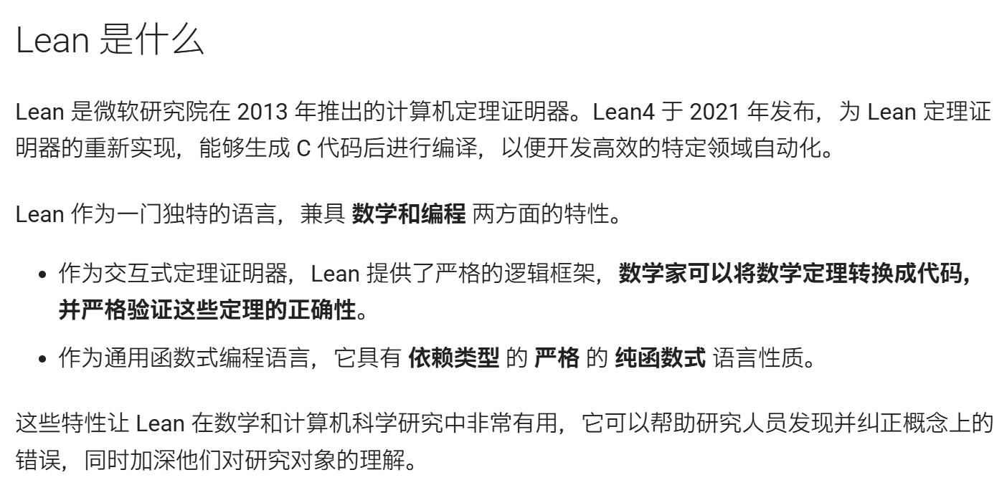

Lean Prover

Slide 21
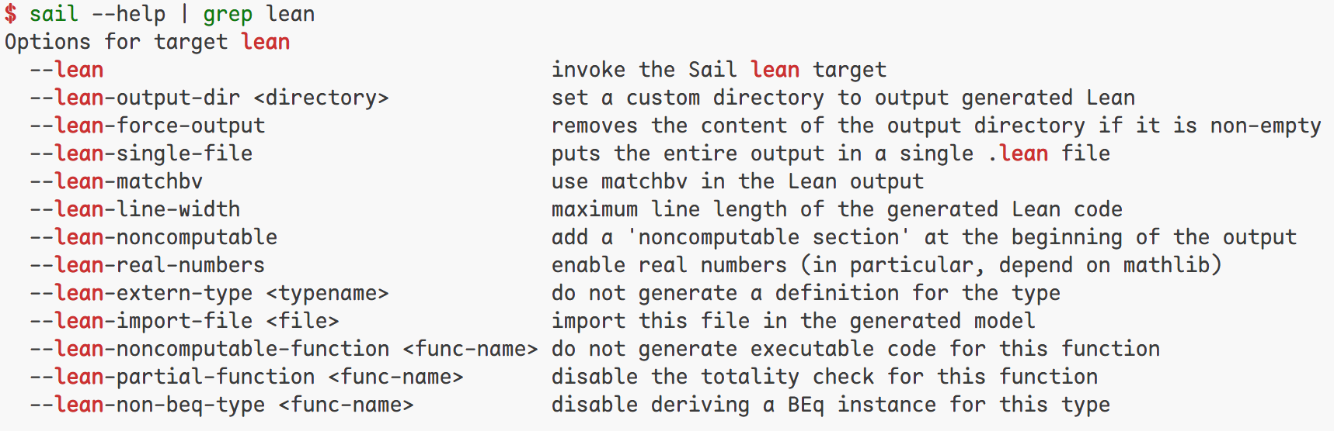
sail lean backend
lean 开发三件套 elan + lake + lean
Rust 中的 rustup + cargo + rustc
Node.js 中的 nvm + npm + node

Slide 22
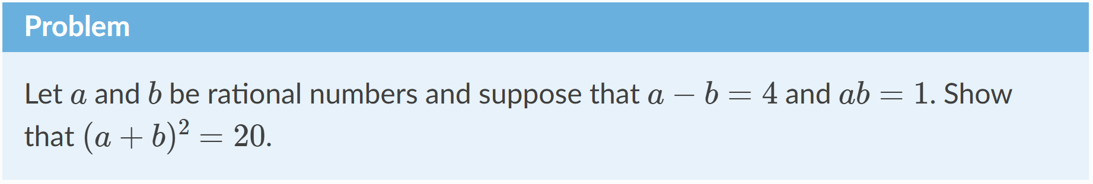
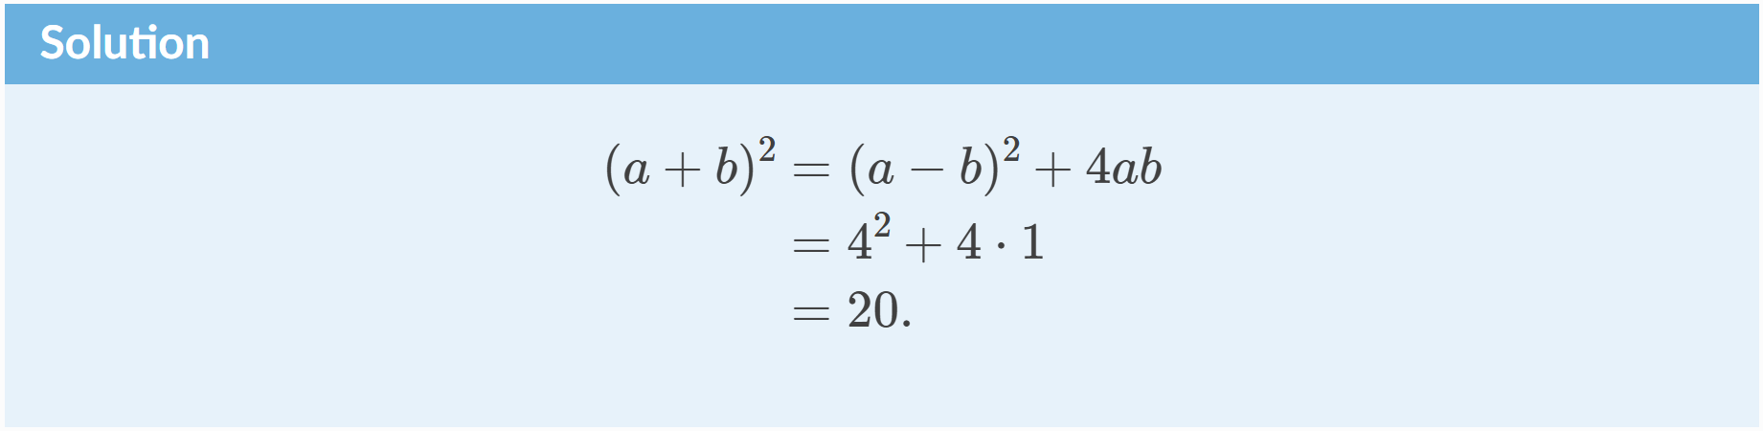
Lean Prover

Slide 23
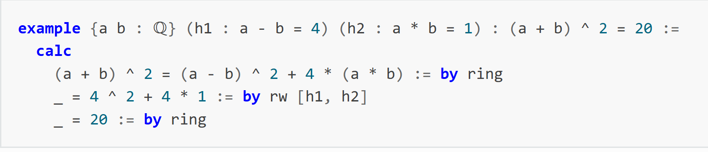
Lean Prover
（代数重排）
（替换）
（代数重排）

Slide 24
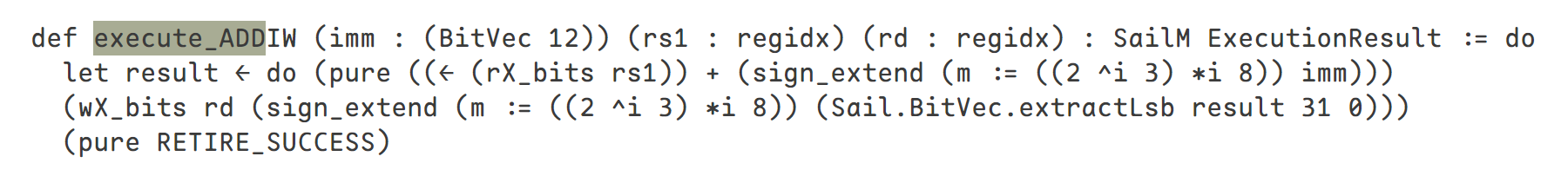
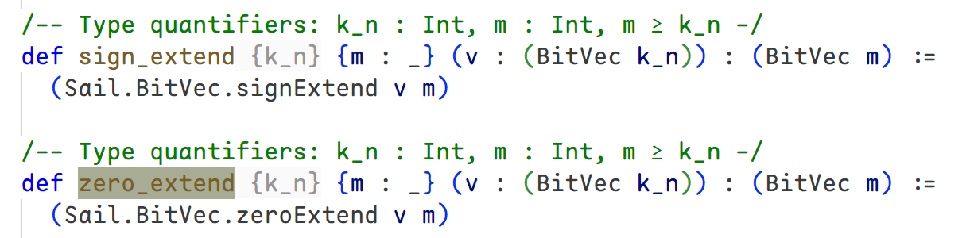
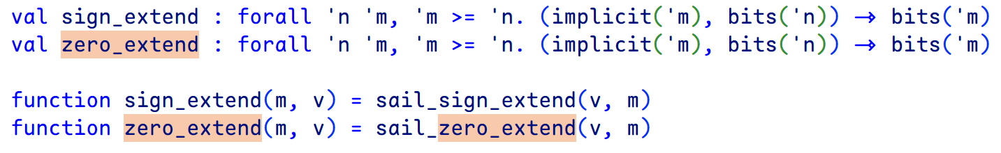
Generated lean code

Slide 25
Generated lean code

Slide 26
4. ACT self-checking mode

Slide 27
Why self-checking
RISCOF - RISC-V Compatibility Framework
python based framework
test a RISC-V target (hard or soft implementations) against a standard RISC-V golden reference model
using a suite of RISC-V architectural assembly tests.
Jeff Scheel clarified: self-checking tests is a key requirement for commercial certification.

Slide 28
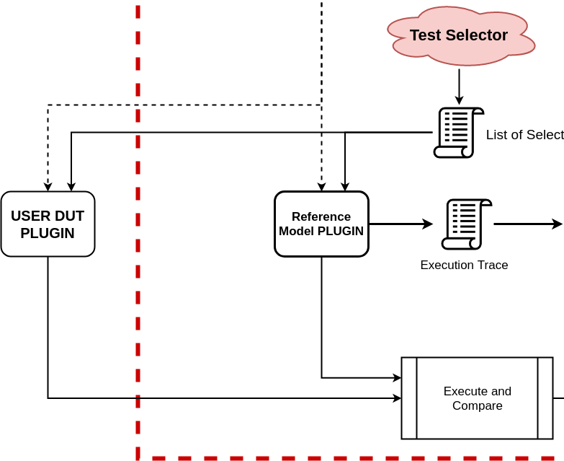
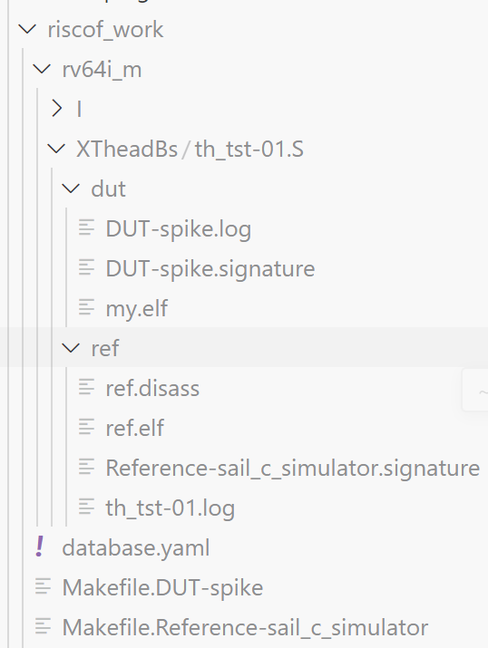
Riscof

Slide 29
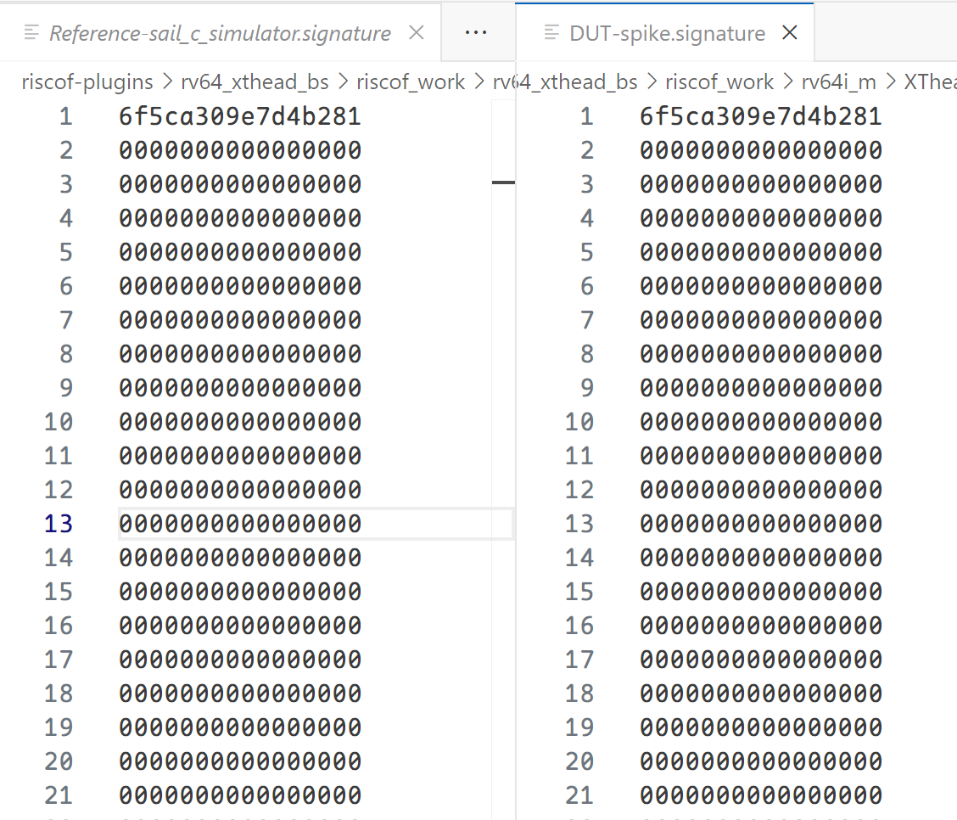
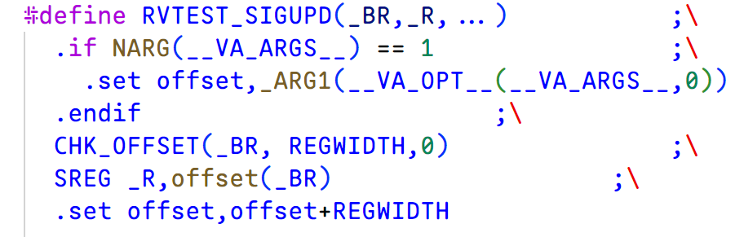
Signature

Slide 30
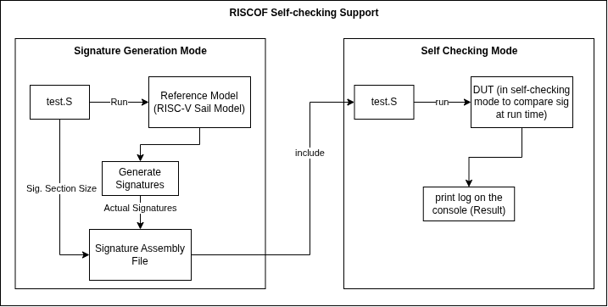
Self-checking mode Implementation

Slide 31
Summary
sail model assembly
riscv-unified-db
sail lean backend
ACT self-checking mode

Slide 32
Thanks

Slide 33
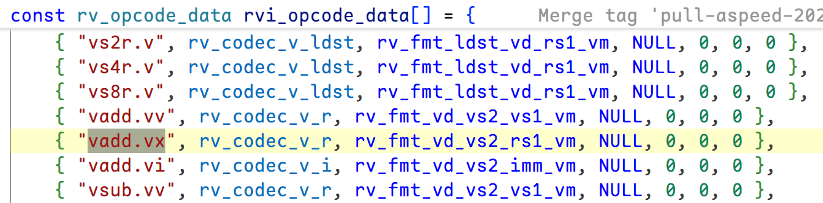
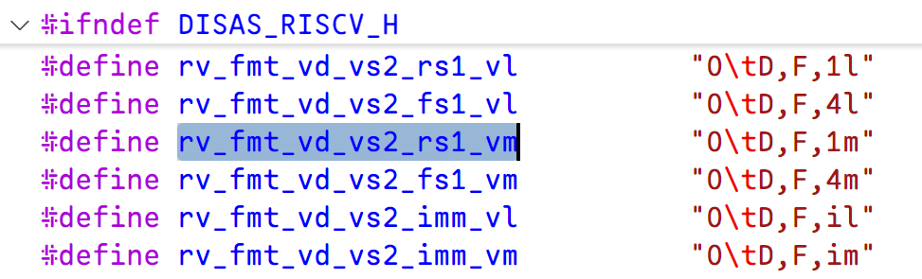
Gas assembly

